Slide 1
An Update on the UK Smart X-Ray Optics Project
Alan Michette & Sławka Pfauntsch
King’s College London
Department of Physics
With acknowledgements to the UK Smart X-Ray Optics Consortium
University College London
The University of Leicester
The Scottish Microelectronics Centre, University of Edinburgh
The University of Birmingham
The Mullard Space Science Laboratory
STFC Daresbury Laboratory
Diamond Light Source Ltd
Silson Ltd
funded by the EPSRC under the Basic Technology Programme
Grant Code D04880X,
and to
Tongji University, Shanghai
funded by Innovation China UK & the Royal Society.
And, of course, supported by EU COST Action MP0601
Short Wavelength Laboratory Sources

Slide 2
Outline
Review of “Conventional” X-Ray Optics
Refractive, Reflective, Diffractive
and their limitations.
Smart X-Ray Optics
Microstructured Optical Arrays
Applications of Focused X-Ray Probes formed from Microfocus X-
Ray Sources
Summary and Conclusions

Slide 3
Summary of “Conventional” X-Ray Optics
 | Suitable for Energy Angle |  | Advantages | Disadvantages
CRLs | >5keV | Normal | “Simple” Insensitive to misalignment | Chromatic aberration Limited resolution
Grazing | Any | <θ_{C} | Achromatic Widely used | Need compound systems Aberrations
Periodic MLMs | Soft | Any | Good wavelength / angle selectivity Wide range of possibilities | Narrowband Susceptible to damage
Aperiodic MLMs | Soft | Any | Broadband Wide range of possibilities Less sensitive to manufacturing errors | Harder to make Less selective
ZPs | “Any” | Normal¹ | Good spatial resolution Multiplicity of foci | Inefficient Small apertures
¹Can also be used in reflection at grazing incidence
Note – combinations of optics, e.g., reflective-diffractive as in Bragg-Fresnel lenses, have also been used. These tend to also combine the advantages and disadvantages.

Slide 4
The King’s College X-Ray Microprobe
We want to study a range of problems in radiation biology:
How are biological cells damaged by ionising radiation?
More specifically, how is response to radiation distributed
across a cell? What is a “safe” dose?
How significant is damage to components other than nuclear DNA?
Prior to the development of a focused x-ray microprobe some results, using α particles, suggested that cytoplasm damage (presumably mitochondrial DNA) may be important.
Can damage effects be transmitted to un-irradiated cells —
the neighbourhood effect?
Statistical analyses of experiments with unfocused x-ray beams had previously suggested that they may be.
Are temporal effects important?

Slide 5
The King’s College X-Ray Microprobe
Historically, experiments using x-rays to study radiation damage were carried out using unfocused beams.
The low-dose responses of cells were ∴ hard to determine as, with soft x-rays, the dose imparted by just a few photons is damaging (1Gy=1J/kg ≡ ~10 absorbed carbon K photons in a cell nucleus). But if the beam is unfocused, the precise dose to each cell is unknown.
How is response to radiation distributed across a cell?
How significant is damage to components other than nuclear DNA?
Can damage effects be transmitted to un-irradiated cells —
the neighbourhood effect?
Questions like these cannot be answered using unfocused beams: at low dose it cannot be known which cells or parts of cells were irradiated; at high dose it is likely that most cells and several parts of the cell were.
Some results have been obtained using α particle and proton probes, but it is not easy to control the precise location of dose within a cell.

Slide 6
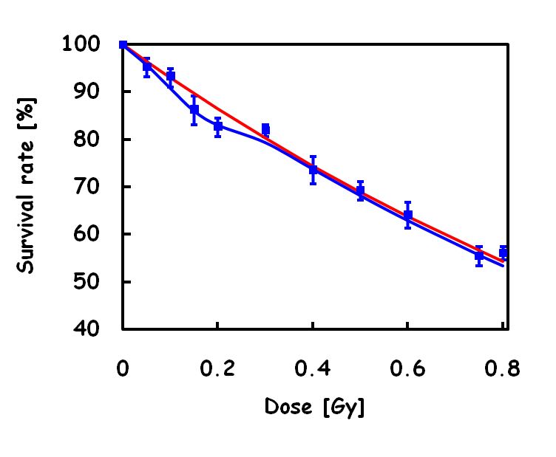
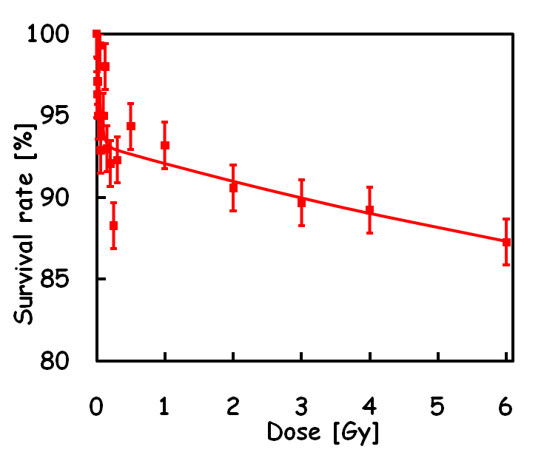
The King’s College X-Ray Microprobe
Microprobing of biological cells using sub-micrometre spots of
focused carbon K x-rays (284eV) has been very successful in studies
relevant to radiation-induced cancers, including:
Low-dose effects, including
low-dose hypersensitivity
(what is a safe dose?).
High-dose extrapolation
Low-dose data
The bystander effect;
if only one cell out of
a population in a dish is
irradiated, up to ~10%
do not survive.
Comparison of cytoplasm and
nucleus irradiation; around
the same percentage of cells seem to
survive irrespective of whether the nucleus
or cytoplasm is specifically irradiated. This suggests that
damage to both nuclear and mitochondrial DNA is important.

Slide 7
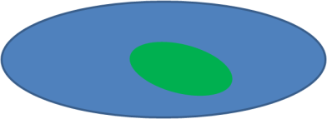
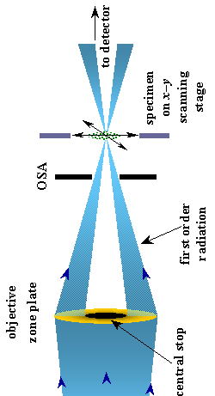
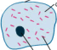
The King’s College X-Ray Microprobe
☹ But there are problems ...
There will always be some cytoplasm irradiation even
when the nucleus is targeted.
Thus tissue samples, of
much more importance for radiation effects in living
organisms, cannot be studied.
C K x-rays can only penetrate one cell; essentially
zero pass through unabsorbed.
To study tissue samples higher energies are needed;
chromium K_{a} (5.4keV) x-rays are suitable.
So far it has only been possible to study effects related
to cell death, rather than mutations which are much more
important in cancer studies. Fortunately, mutations are
much rarer; on average, if ≈10,000 cells are given a
specific (low) dose, ≈9999 will repair correctly or die; only
≈1 will repair incorrectly (mutate). Very few of those that
do mutate are potentially cancerous.

Slide 8
The King’s College X-Ray Microprobe
Experiments so far have been done using zone plates, with a focal
spot size limited by the demagnified source.
UV assay
microscope
Source size ≈5µm, focal spot ≈0.2µm for C K,
≈4µm for Cr K, since f ∝E.
Focused flux limited by:
(mononchromatic) source output;
efficiency and aperture of optic
(A_{eff}~10⁻⁹ for a typical zone plate).
Cells on xyz stage
Pinhole (OSA)
Zone plate
To study mutations in tissue samples, and to
disentangle nucleus/cytoplasm effects, need:
Source exit
window
higher source output;
smaller source size (≈1µm);
Monochromator
higher demagnification;
higher efficiency and/or aperture optic —
, with 24/7 access.
all at keV energies
These factors define the design
goals of the new microprobe.

Slide 9
The Microfocus Source
How can we get a 1µm source size?
The electron accelerating voltage must not be too high, to optimise K
x-ray production, limit secondary electron range and prevent high
energy bremsstrahlung — 15keV selected as suitable for ~5keV x-rays.
This limits the beam current, in order to limit divergence which would increase the size of the electron focus.
FEA calculations show that ~1mA can be focused into a ~1µm spot, a power density of ~2x10¹³W/m².
The original plan was to use a titanium target (4.5keV), but at such power densities Ti will melt (FEA), even with liquid N₂ cooling, due to its low melting point (1935K) and thermal conductivity (22W/m/K).
Now planning to use liquid N₂ cooled chromium, melting point 2180K and thermal conductivity 94W/m/K.

Slide 10
Micro-Structured Optical Arrays
Grazing incidence reflective arrays loosely based on polycapillaries.
Polycapillary optics use bundles of capillaries, e.g., microchannel
plates, to provide multiple grazing incidence reflections along
many circular, or square, or hexagonal ... channels. Useful as
relay optics, but limited resolution capabilities.
Single or multiple purpose-built arrays.
Piezo coated (unimorph or bimorph).
Arrays can be bent either actively or adaptively to reduce aberrations
and/or to provide variable focus and magnification.
The aim is to provide significantly more focused flux in a sub-
micrometre spot than can be achieved with a zone plate.
Current status: Modelling using ray tracing and finite element analysis.
Prototype components developed, tested & improved.

Slide 11
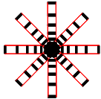
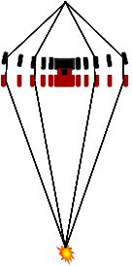
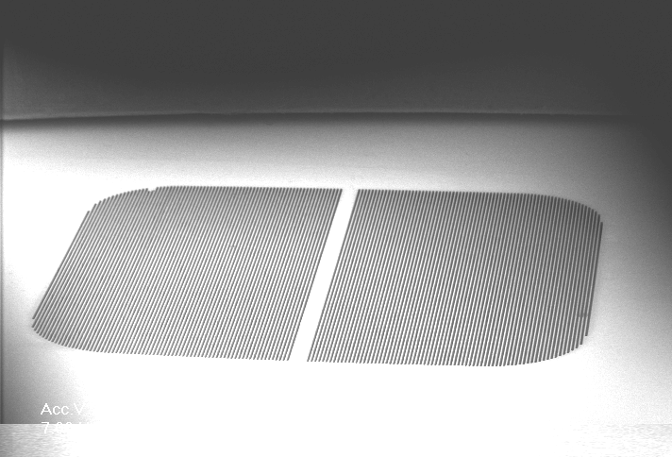
Micro-Structured Optical Arrays
Quasi-circularly symmetric or straight arrays of channels
etched into silicon (and possibly coated).
By using single grazing incidence reflections in each of
two arrays the Abbe sine can be approximately
satisfied, thereby reducing aberrations.
Bending one or both arrays can further reduce aberrations
and give variable focal length.
Prototype design for 5.4keV:
≈10µm channels, 20µm period
2mm diameter (2mm square for 1D prototype)
50-200µm thick silicon
second component bending radius ≈5cm
focal length ≈5cm.
With ≈1nm sidewall roughness, as achieved by wet etching, this gives
over 100× as much focused flux as a typical zone plate — even more if
the application allows bremsstrahlung to be used.

Slide 12
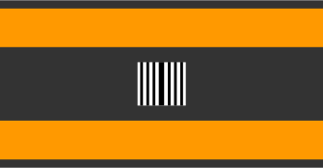
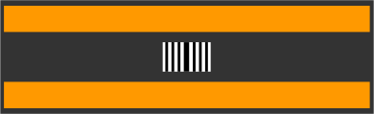
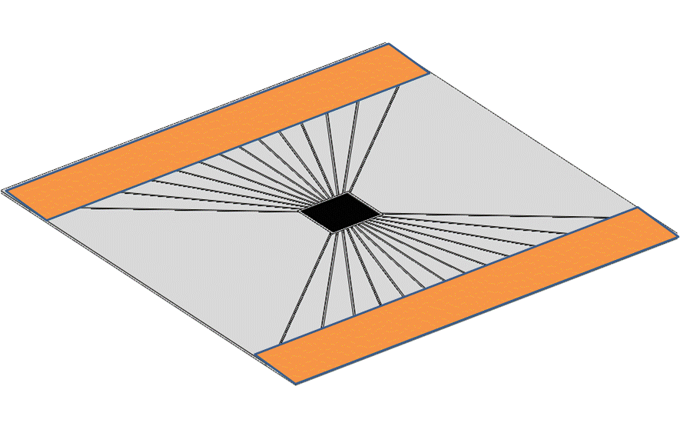
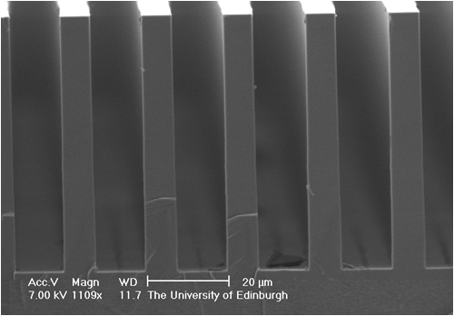
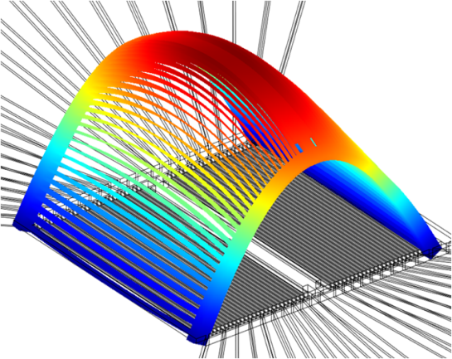
Micro-Structured Optical Arrays
Mechanical bending induced high stress points and was bulky.
First attempts at bending by direct piezo actuation were also
not successful; minimum radius of curvature was ≈15cm (FEA
and experiment).
Now trying indirect piezo actuation, using an arrangement of
levers — the “spider array”; FEA suggests this will work.*
An average bending radius of 5cm can be achieved,
with an approximately parabolic profile (giving a better
focus than a circular one) at a maximum stress of ≈40%
of the silicon breaking stress.
Now exploring ways of making these, through a
combination of (directional) wet etching for the active
channels (to get the smooth walls) and dry etching for
the levers (to get the angles needed).‡
*The originator of the “spider array” concept is Daniel Rodriguez-Sanmartin,
University of Birmingham
‡The arrays are made by Camelia Dunare, Scottish Microelectronics Centre

Slide 13
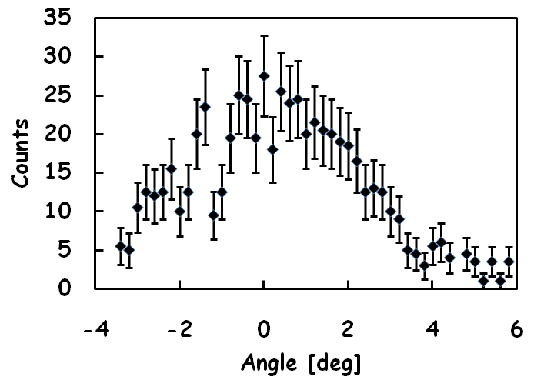
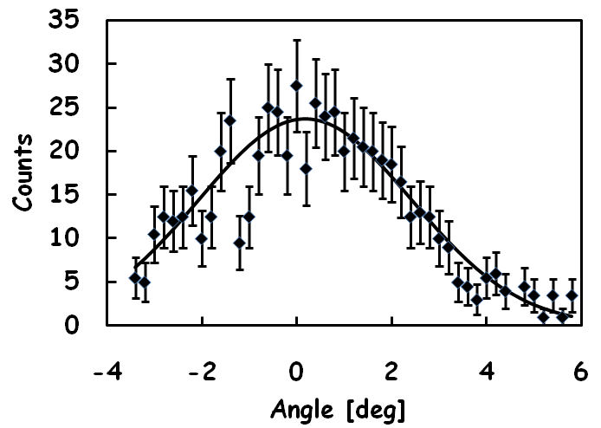
Micro-Structured Optical Arrays
Reflectivity Tests
The reflectivity of an unbent wet etched array was measured using ≈500eV x-rays, by relatively rotating the source and array in front of a CCD.*
0° is defined as the angle at which most x-rays should be reflected. Away from 0° the observed count rate falls since more x-rays pass straight through (negative angles) or undergo multiple reflections (positive).
Reflectivity was expected over a range of ≈5°. The fitted Gaussian peak is at 0.2°, with a FWHM of 5.3°.
A preliminary analysis suggests that the peak reflectivity is a few percent (at a much larger glancing angle than will be used in practice), consistent with the AFM measured channel wall roughness of 1.2nm.
*The measurements were done by Charlotte Feldman, University of Leicester.

Slide 14
Summary
☺ Soft x-ray microprobes have demonstrated their use in
studying a range of problems in radiation biology of single cells.
☹ But to extend these studies to mutation effects in tissue
samples, it is necessary to:
❶ Use higher energy x-rays;
❷ Deliver more focused flux.
☺ It seems feasible that these goals can be achieved by:
❶ Using a chromium microfocus source with a ≈1µm source size
(under construction);
❷ Using microstuctured optical array optics, with A_{eff}>100x
that of a typical zone plate.
❸ May need to define a route to true 2-D focusing.

